Slide 1




MANUEL S. ENVERGA UNIVERSITY FOUNDATION
COLLEGE OF COMPUTING AND MULTIMEDIA STUDIES
CHED CENTER OF DEVELOPMENT IN IT EDUCATION
LINEAR
SEARCH
ALGORITHM

Slide 2




GROUP 1
MEMBERS
AMREI LOUIS A. ESPARES
JHORAM EZEKIEL C. BALA
DANIEL RICHARD S. GUINTO
PETER BOB R. DOMOGMA

Slide 3

Learning Outcomes
Define linear search algorithm
Recognize the limitations of linear search and compare it to more efficient algorithms like binary search, especially in sorted datasets.
Recognize Limitations: Understand why linear search may not be suitable for large datasets or frequently repeated searches
Write a function to search for a specific value in an array
Implement search functionality in a real-world project
Learn how the linear search algorithm sequentially checks each element to find a match.

Slide 4
What is Linear Search?
Linear search algorithm is the simplest searching algorithm that is used to find an element in the given collection.
It simply compares the element to find with each element in the collection one by one till the matching element is found or there are no elements left to compare.

Slide 5
Applications of Linear Search
Unsorted Lists: When we have an unsorted array or list, linear search is most commonly used to find any element in the collection.
Linear search is commonly used in datasets where the data is unsorted or unordered.
Example: Searching for a specific book in a library database where the records are not sorted alphabetically.

Slide 6
Applications of Linear Search
Small Data Sets: Linear Search is preferred over binary search when we have small data sets.
Ideal for searching in small datasets, where its simplicity outweighs the inefficiency of O(n)O(n)O(n) complexity.
Example: Finding an item in a short list of customer preferences or recently accessed files.

Slide 7
Applications of Linear Search
Searching Linked Lists: In linked list implementations, linear search is commonly used to find elements within the list. Each node is checked sequentially until the desired element is found.
For linked lists, where random access is not possible, linear search is often used to traverse the list to find a target element.
Example: A list of students, each containing details like ID, name, and grade, is stored in a linked list. Linear search is used to find a specific student by ID or name, and Checking if a student exists before adding new grades.

Slide 8
Applications of Linear Search
Simple Implementation: Linear Search is much easier to understand and implement as compared to Binary Search or Ternary Search.
Used in teaching basic search algorithms due to its simple and intuitive implementation.
Students can learn algorithm design and efficiency concepts through linear search.

Slide 9
Advantages of Linear Search
Linear search can be used irrespective of whether the array is sorted or not. It can be used on arrays of any data type.
Does not require any additional memory.
It is a well-suited algorithm for small datasets.

Slide 10
Disadvantages of Linear Search
Linear search has a time complexity of O(N), which in turn makes it slow for large datasets.
Not suitable for large arrays.

Slide 11
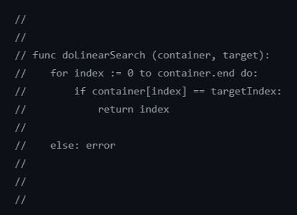
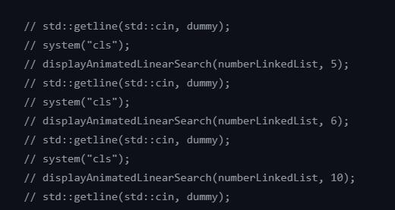
Pseudocode Algorithm

Slide 12
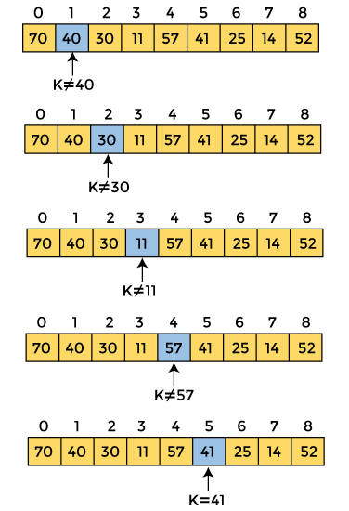
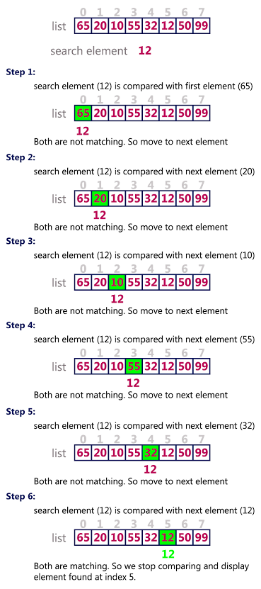
Examples of Linear Search

Slide 13
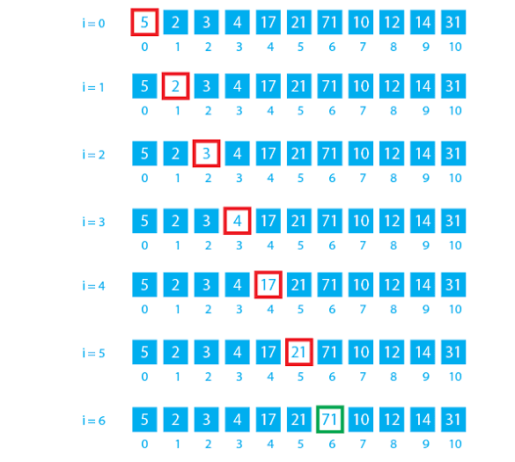
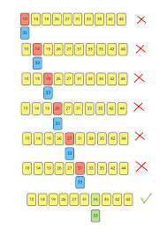
Examples of Linear Search

Slide 14
Source Code Implementation
https://github.com/Allie1080/linear-search-datastruct

Slide 15
MANUEL S. ENVERGA UNIVERSITY FOUNDATION
COLLEGE OF COMPUTING AND MULTIMEDIA STUDIES
CHED CENTER OF DEVELOPMENT IN IT EDUCATION
THANK
YOU!

